Slide 1
Chapter 3: Information Technology Infrastructure

Slide 2
3.1 IT Infrastructure and Emerging Technologies
IT infrastructure: Set of physical devices and software required to operate enterprise
Set of firm wide services including:
Computing platforms providing computing services
Telecommunications services
Data management services
Application software services
Physical facilities management services
IT management, education, and other services

Slide 3
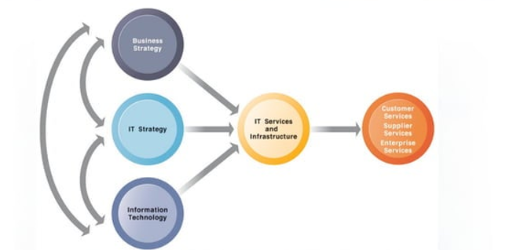
CONNECTION BETWEEN THE FIRM, IT INFRASTRUCTURE, AND BUSINESS CAPABILITIES
Figure 3-1 The services a firm is capable of providing to its customers, suppliers, and employees are a direct function of its IT infrastructure. Ideally, this infrastructure should support the firm’s business and information systems strategy. New information technologies have a powerful impact on business and IT strategies, as well as the services that can be provided to customers.

Slide 4
Evolution of IT infrastructure
Five major stages:
Mainframe and Minicomputer Era (1959-Present)
Centralized computing with large mainframes
Personal Computer (PC) Era (1981-Present)
Introduction of standalone desktop computers
Client/Server Era (1983-Present)
Networked computers for resource sharing
Enterprise Computing Era (1992-Present)
Integration of IT across organizations
Cloud and Mobile Computing Era (2000-Present)
Shift towards internet-based computing and storage

Slide 5
Technology Drivers of IT Evolution
Moore’s Law and Microprocessing Power
Computing power doubles every two years, reducing costs.
The Law of Mass Digital Storage
Storage costs decrease as capacity increases.
Declining Communications Costs and the Internet
Internet growth reduces communication costs.
Standards and Network Effects
Common standards drive technological compatibility and adoption.

Slide 6
Components of IT Infrastructure
Seven major components:
Computer hardware platforms
Operating system platforms
Enterprise software applications
Data management and storage
Networking/telecommunications platforms
Internet platforms
Consulting and system integration services

Slide 7
Computer hardware platforms
Client machines
Desktop PCs, laptops
Mobile computing: smartphones, tablets
Servers
Blade servers: ultrathin computers stored in racks
Mainframes: IBM mainframe equivalent to thousands of blade servers
Top chip producers: Intel, AMD

Slide 8
Cont..
Operating system platforms
Operating systems
Server level: 65% run Unix or Linux; 35% run Windows
Client level:
90% run Microsoft Windows (Windows 8, Windows 7, etc.)
Mobile/multitouch: Android, iOS
Cloud computing: Google's Chrome OS
Enterprise software applications
Enterprise application providers: SAP and Oracle

Slide 9
Cont..
Data management and storage
Database software:
IBM DB2, Oracle, Microsoft SQL Server
Sybase (Adaptive Server Enterprise), MySQL
Physical data storage:
EMC Corp (large-scale systems), Seagate, Western Digital
Storage area networks (SANs):
Connect multiple storage devices on dedicated networks

Slide 10
Cont..
Networking/telecommunications platforms
Telecommunication services
Telecommunications, cable, telephone company charges for voice lines and Internet access
AT&T, Verizon
Network operating systems:
Windows Server, Linux, Unix
Network hardware providers:
Cisco, Alcatel-lucent/junipter networkers

Slide 11
Cont..
Internet platforms
Hardware, software, management services to support company Web sites (including Web-hosting services), intranets, extranets
Internet hardware server market: IBM, Dell, Sun (Oracle), HP
Web development tools/suites: Microsoft Visual Studio and .NET, Oracle-Sun Java, Adobe, Real Networks

Slide 12
Cont..
IT Infrastructure Components
Consulting and system integration services
Even large firms do not have resources for full range of support for new, complex infrastructure
Leading consulting firms: Accenture, IBM Global Services, HP, Infosys, Wipro Technologies
Software integration: ensuring new infrastructure works with legacy systems
Legacy systems: older TPS created for mainframes that would be too costly to replace

Slide 13
Current Trends in Hardware Platforms
The mobile digital platform
Smartphones (iPhone, Android, and Blackberry)
Data transmission, Web surfing, e-mail, and IM
Netbooks:
Small lightweight notebooks optimized for wireless communication and core tasks
Tablets (iPad)
Networked e-readers (Kindle and Nook

Slide 14
3.3 Management
Greening of the Data Center
1. What are Business and Social Problems Caused by Data Center Power Consumption?
2. What solutions are available for these problem ? Are they management , organizational or technological ? Explain your answer
3.What are the business benefit and cost of this solutions?
4. Should all firm move toward green computing ?why or why not?

Slide 15
Current Trends in Hardware Platforms
BYOD (Bring your own device)
Allowing employees to use personal mobile devices in workplace
Consumerization of IT
New information technology emerges in consumer
markets first and spreads to business organizations
Forces businesses and IT departments to rethink how
IT equipment and services are acquired and managed

Slide 16
Cont..
Quantum computing
- Uses quantum physics to represent and operate on
- Dramatic increases in computing speed
Virtualization
- Allows single physical resource to act as multiple
- resources (i.e., run multiple instances of OS)
Reduces hardware and power expenditures
Facilitate hardware centeralization

Slide 17
Cont..
Cloud computing
On-demand (utility) computing services obtained over network
Infrastructure as a service (laaS)
Platform as a service PaaS
Software as a service SaaS
Cloud can be public or private
Allows companies to minimize IT investments
Drawbacks: Concerns of security, reliability

Slide 18
Green computing (Green IT)
Practices and technologies for manufacturing,
using, disposing of computing and networking hardware
Reducing power consumption a high priority
IT responsible for 2% U.S. power demand
High performance, power-saving processors
Multi-core processors
Power-efficient microprocessors

Slide 19
Thank you!!

